Slide 1


“How do Elon Musk’s tweets influence crypto prices?”
Project 3 – Data Thieves
Data Anlytics
Giorgio Gião

Slide 2

Index
01. Overview
02. Crypto prices & Elon Musk’s tweets
03. Crypto price evolution vs Tweets
04. Conclusion

Slide 3
01
Overview

Slide 4
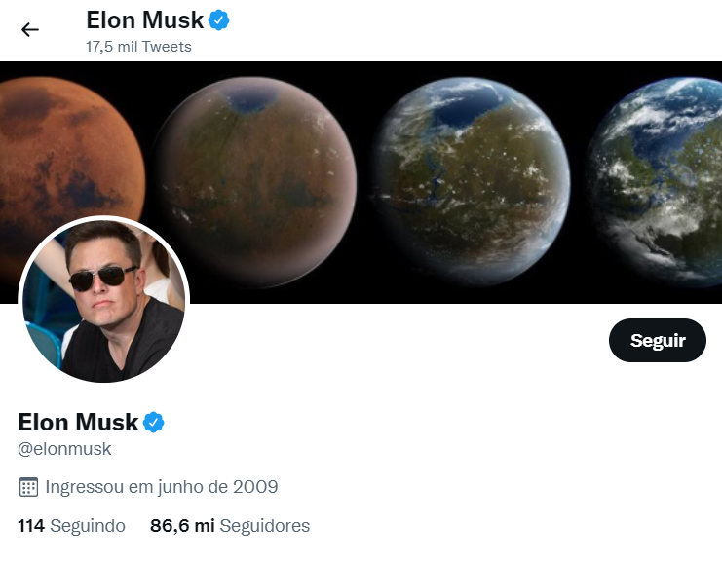


Data
“How do Elon Musk’s tweets influence crypto prices?”
Datasets
Elon Musk’s tweets 2010-2022 (source: kaggle)
Tweet date
Tweet content
Number of retweets
Historic crypto prices (source: Yahoo finance)
Daily closing price
Date
API
CoinGecko API
Daily closing price
Date

Slide 5
Calculated Variables
“How do Elon Musk’s tweets influence crypto prices?”
Tweets reach
We will label each tweet depending on the number of retweets:
<8k: Very Low
8k – 16k: Low
16k – 60k: Moderate
60k – 120k: High
>120k: Very High
Crypto Price Growth
TD+1 = (Tweet day + 1)
TD+2 = (Tweet day + 2)
TD +3 = (Tweet day + 3)
Crypto Price Growth Tendency
5 days
(Tweet day - 2) -> (Tweet day + 2)
2 days prior
(Tweet day – 2) -> Tweet day
2 days after
Tweet day -> (Tweet day + 2)

Slide 6
02
Crypto Prices & Elon Musk’s tweets

Slide 7
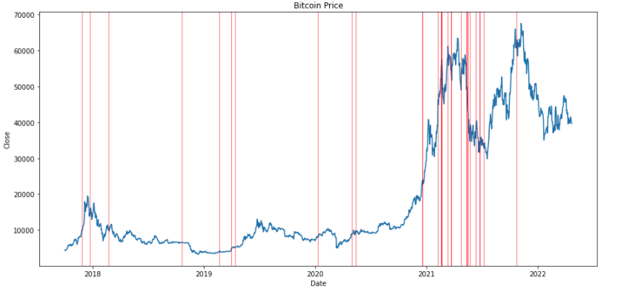
Bitcoin price & Elon Musk’s tweets
“How do Elon Musk’s tweets influence crypto prices?”
Bitcoin price
Elon Musk’s tweets
From 2018 to 2021, Elon Musk has mentioned bitcoin in his tweets a couple of times per year;
From 2021 to 2022, there was a high number of tweets related to Bitcoin. During this period, we can also see that the Bitcoin price presented high fluctuations (+300% and -50% during this year);

Slide 8
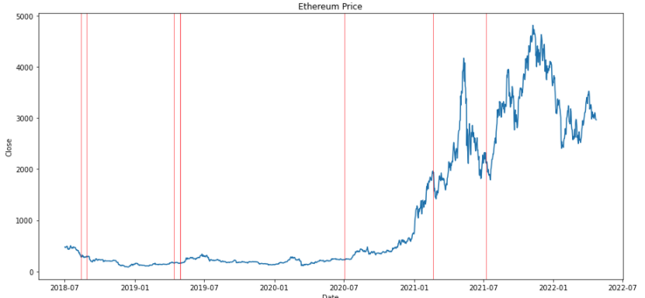
Ethereum price & Elon Musk’s tweets
“How do Elon Musk’s tweets influence crypto prices?”
Ethereum price
Elon Musk’s tweets
Comparing to the Bitcoin chart, Ethereum has been less mentioned on twitter by Elon Musk;
From 2018 to 2021, Elon Musk has mentioned Ethereum in his tweets a couple of times per year;
From 2021 to 2022, Ethereum was only mentioned 2 times. The first time was after a big positive move and the second after a negative move.

Slide 9
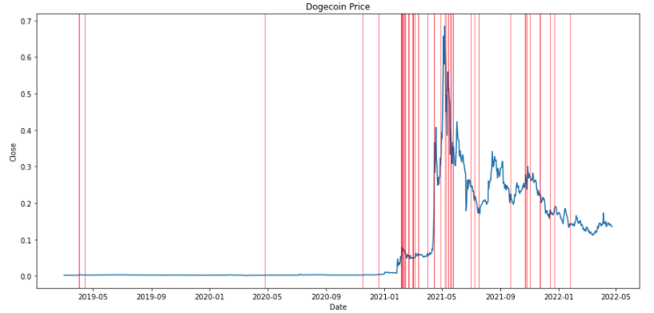
Dogecoin price & Elon Musk’s tweets
“How do Elon Musk’s tweets influence crypto prices?”
Dogecoin price
Elon Musk’s tweets
From all cryptos, Dogecoin is by far the most mentioned on twitter by Elon Musk;
On the chart we can see thick red lines, that result from multiple tweets in a short period of time in the last year;
These tweets started after a rapid and elevated rise in price early 2021;
We can also see that the thicker lines usually fall in price peaks or bottoms;

Slide 10
03
Crypto Price Evolution vs Tweets

Slide 11
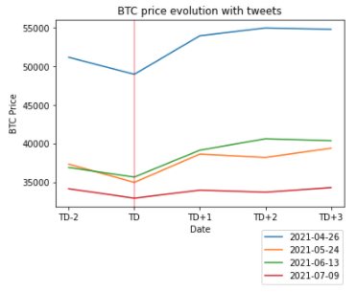
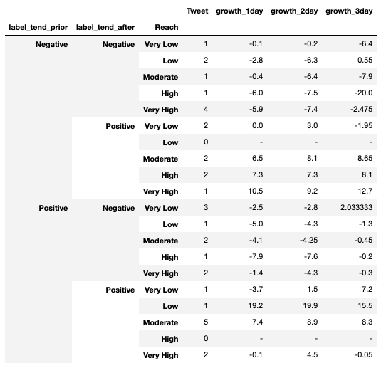
Bitcoin price evolution vs Tweets
“How do Elon Musk’s tweets influence crypto prices?”
We can see that only the values marked inside Orange box may have been influenced by Elon Musk Tweets.
We can also see that when tendency is Positive-Positive, we also have a couple of elevated growths on day 1 but will keep them aside as the price was already growing.
In the marked tweets we can see a strong growth on TD+1.

Slide 12
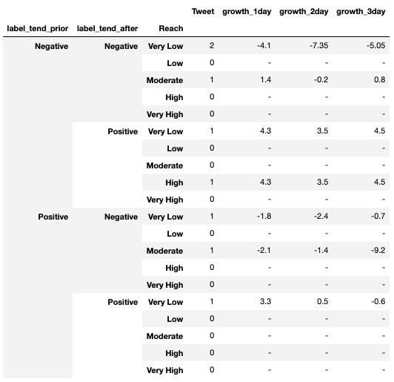
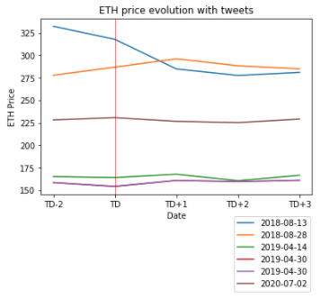
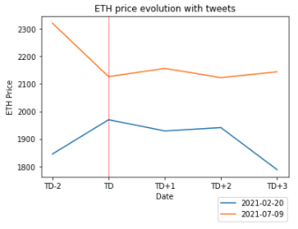
Ethereum price evolution vs Tweets
“How do Elon Musk’s tweets influence crypto prices?”
Ethereum has not been mentioned by Elon Musk on Twitter very often.
From the tweets he has made only 1 of them had a high reach and it resulted in a change of tendency from negative to positive.
The rest of the tweets don’t really show us any possible meaningful variations.

Slide 13
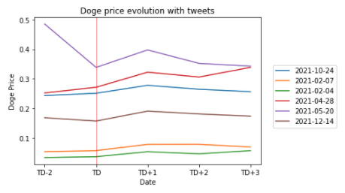
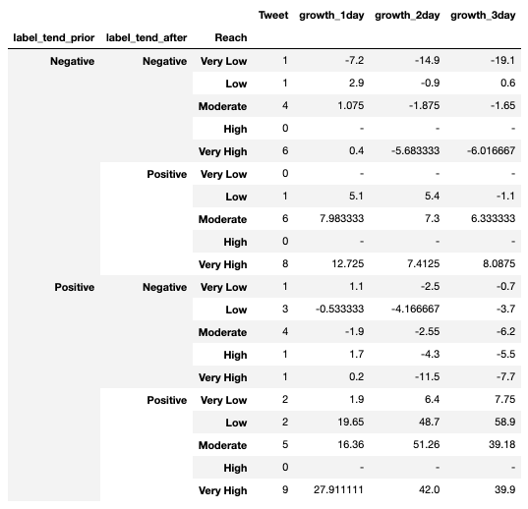
Dogecoin price evolution vs Tweets
“How do Elon Musk’s tweets influence crypto prices?”
We can clearly see that Dogecoin has been the most mentioned crypto on Elon Musk’s twitter.
In general, Elon’s tweets have a positive influence over the price of Dogecoin.
Most tweets with reach above Moderate have presented positive growth on TD+1 independent of the market tendency.
We can also see that the growth from TD to TD+1 is in general the highest.

Slide 14
04
Conclusions

Slide 15
Conclusions
“How do Elon Musk’s tweets influence crypto prices?”
From the overall tweets, Elon Musk has mentioned Dogecoin and Bitcoin the most. First tweet regarding Bitcoin was late in 2017 and for Dogecoin was late 2018.
Elon Musk started tweeting more often about cryptos early 2021 once the prices started rising substantially.
In Bitcoin, we can see some price growth on the day after the tweet when filtering tweets with elevated reach, but it is not consistent. In Ethereum, since we have fewer tweets it is hard to take conclusions.
Dogecoin has shown the biggest growths in the day after the tweet and positive growths even when the tendency was negative. We also have a higher number of tweets which enable us to see the impact of the reach of each tweet in price
From the analysis we can conclude that the crypto price could be affected by Elon Musk’s tweets which is more visible in Dogecoin which has less users and is more likely to have big price variations due to his reach and influence.

